Slide 1

Fast fingers

Slide 2
ABSTRACT
Usually people use their pointers to hit one key at a time and spell out words and punctuation. This has also been called the “Hunt and Peck” method. Alternatively, it’s possible to place your whole hands down on the keyboard with fingers resting lightly on the A, S, D, F and ;, J, K, L keys, and thumbs hovering over the space bar. So,our project will enhance the users to approach this touch typing that it also gives a certain amount of beginner knowledge so users type the right keys with the right fingers. users feel comfortable while typing and they can execute them at top speed and users can also practice on programmingLaguages. Lastly, they do it without looking down at the keyboard!

Slide 3
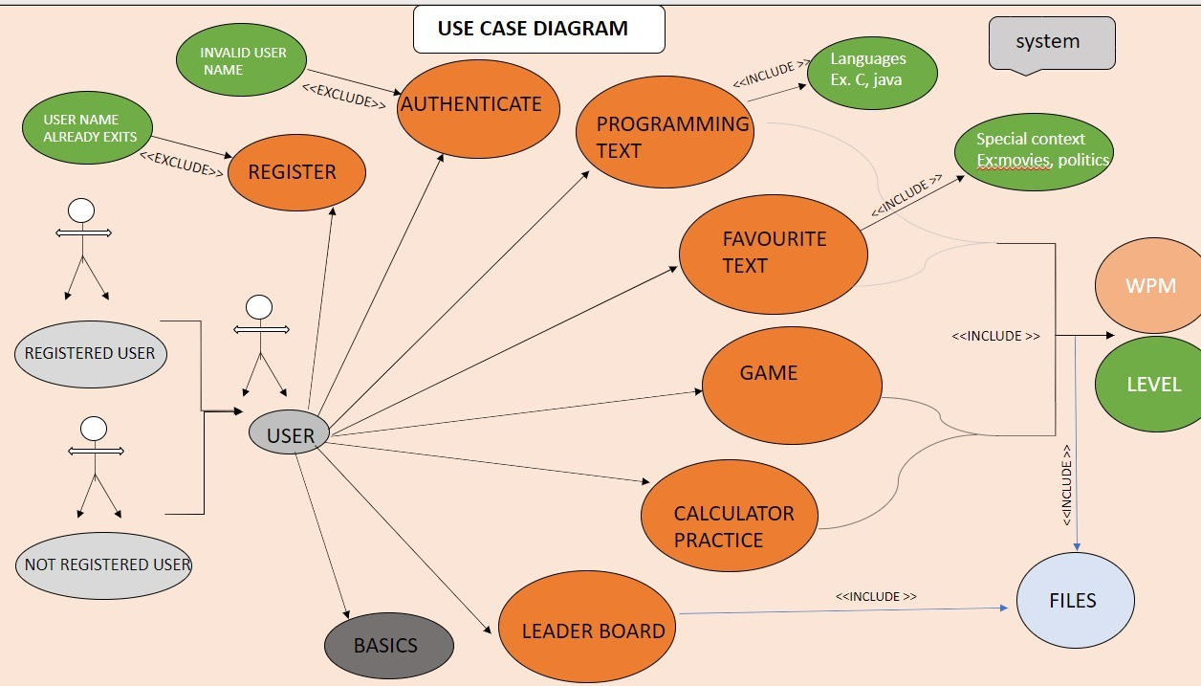
USE CASE DIAGRAM

Slide 4
TECHNOLOGY USED
The software and hardware requirements for the project are:
HARDWARE REQUIRMENTS
Processor : Intel (IR) Core(TM) /Ryzen.
Processor Speed : 250 MHz to 833MHz
RAM : 512MB to 1024 MB
Hard Disk : minimum(2GB ) to 30GB
Standard Input : (QWERT)Key Board
System Type : 32-bit processing system(can be more)
SOFTWARE REQUIRMNETS
Software : gcc compiler
Language : C Programming Language
Operating System : Windows XP (or greater version)/Linux
Web Technologies : Console based project

Slide 5
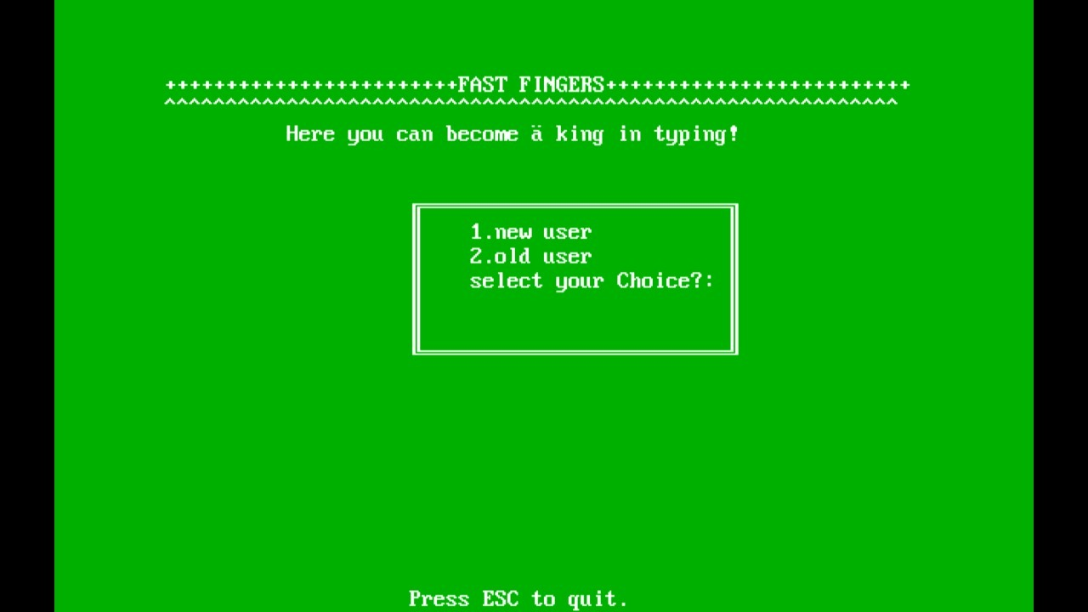
RESULTS

Slide 6
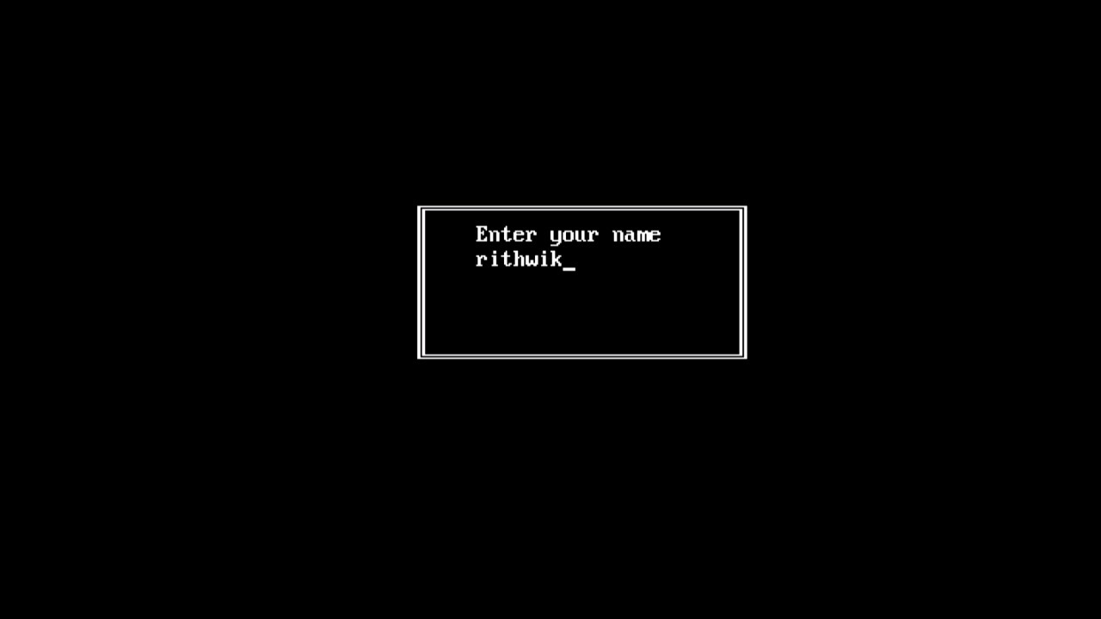

Slide 7
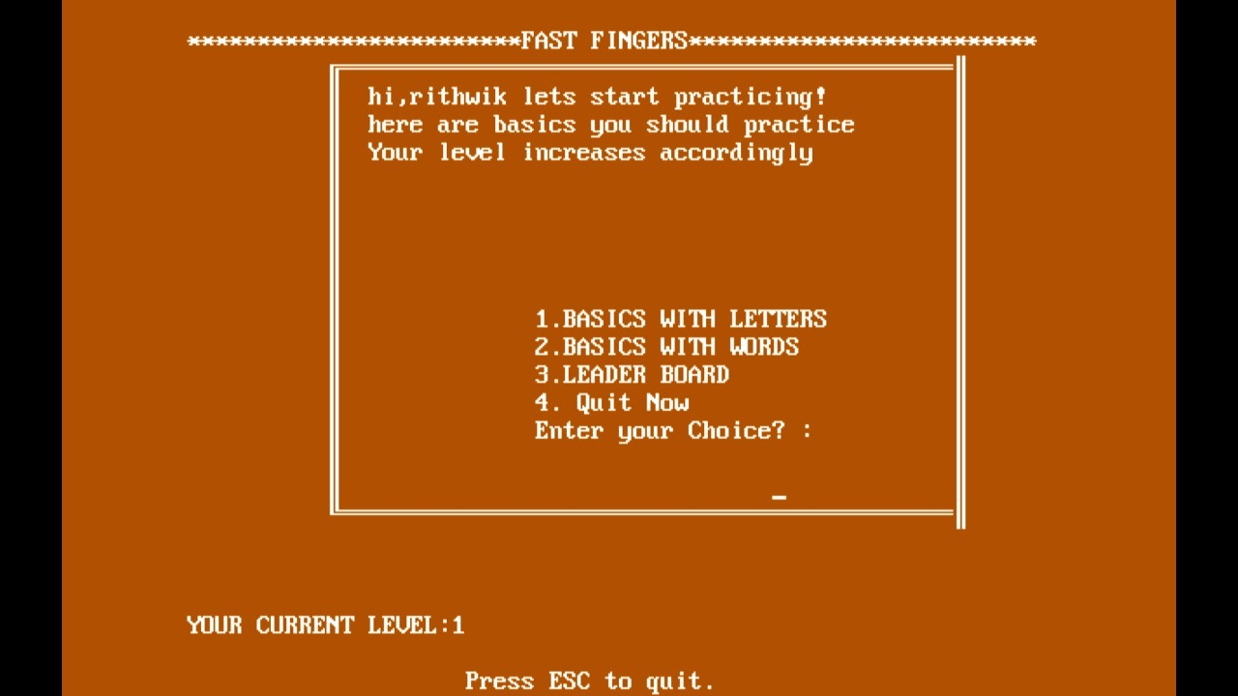

Slide 8
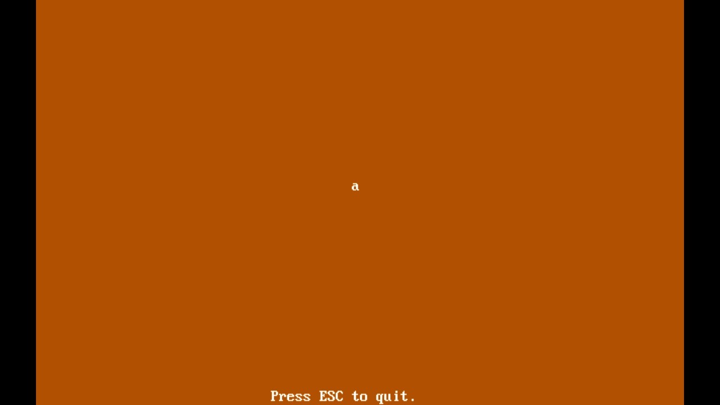

Slide 9
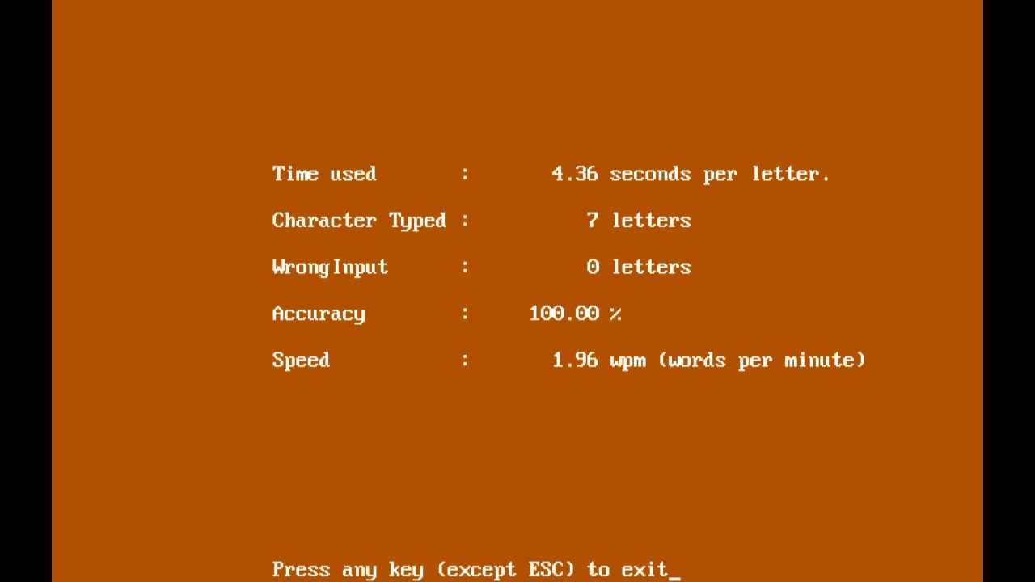

Slide 10
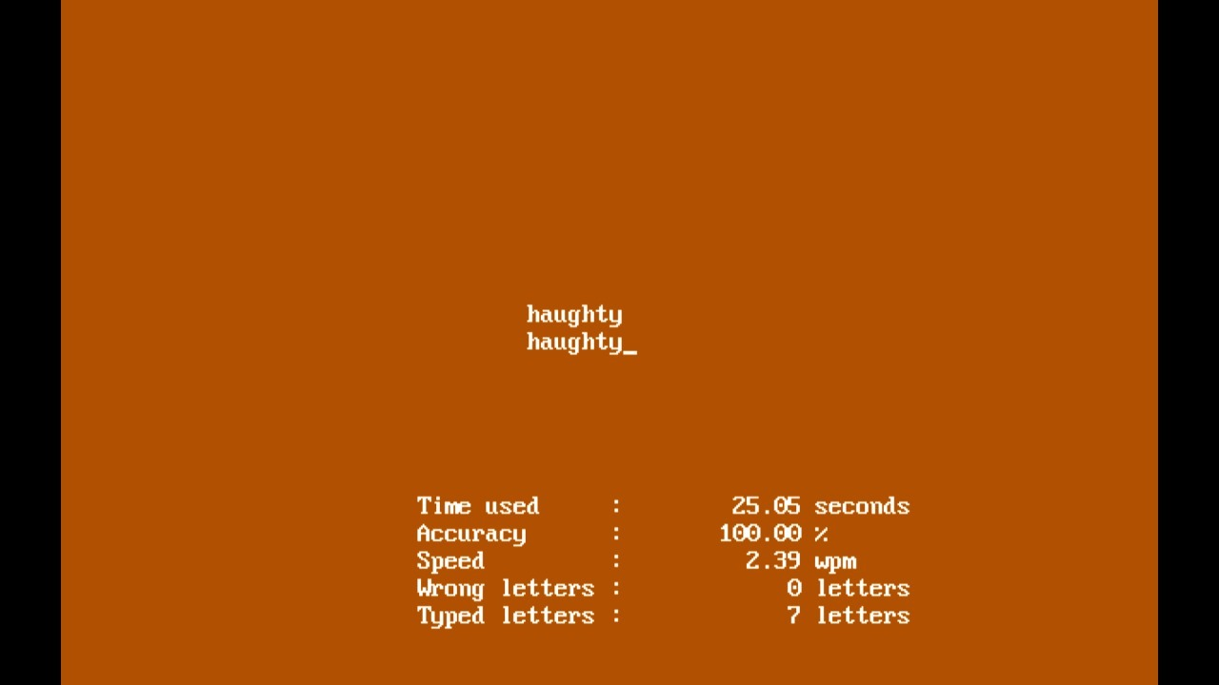

Slide 11
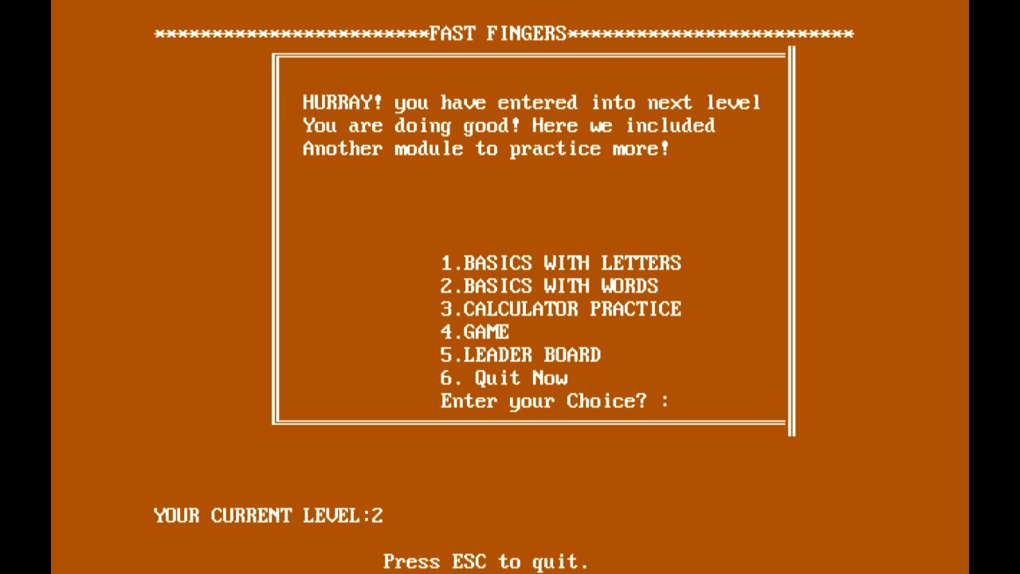

Slide 12
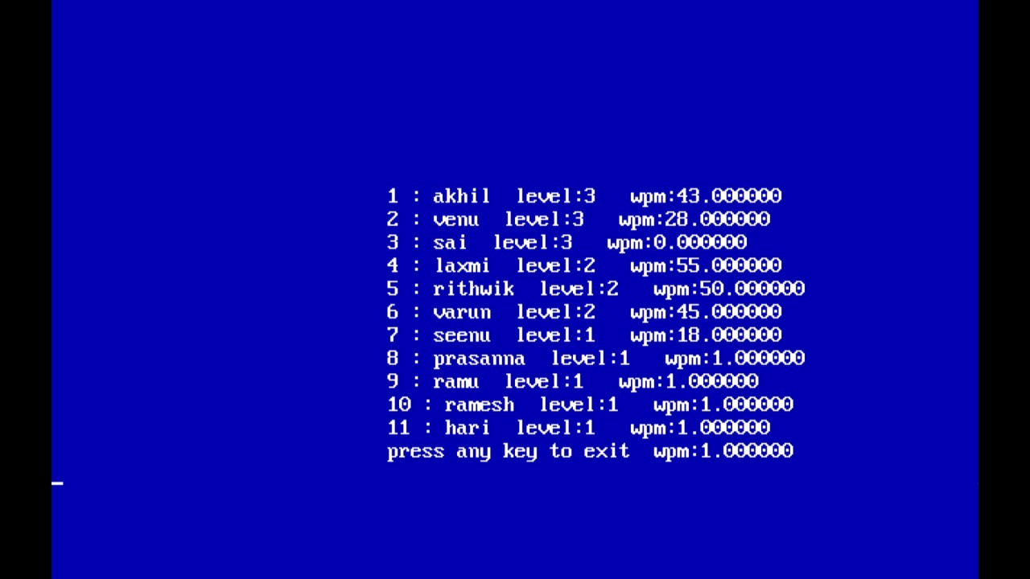

Slide 13
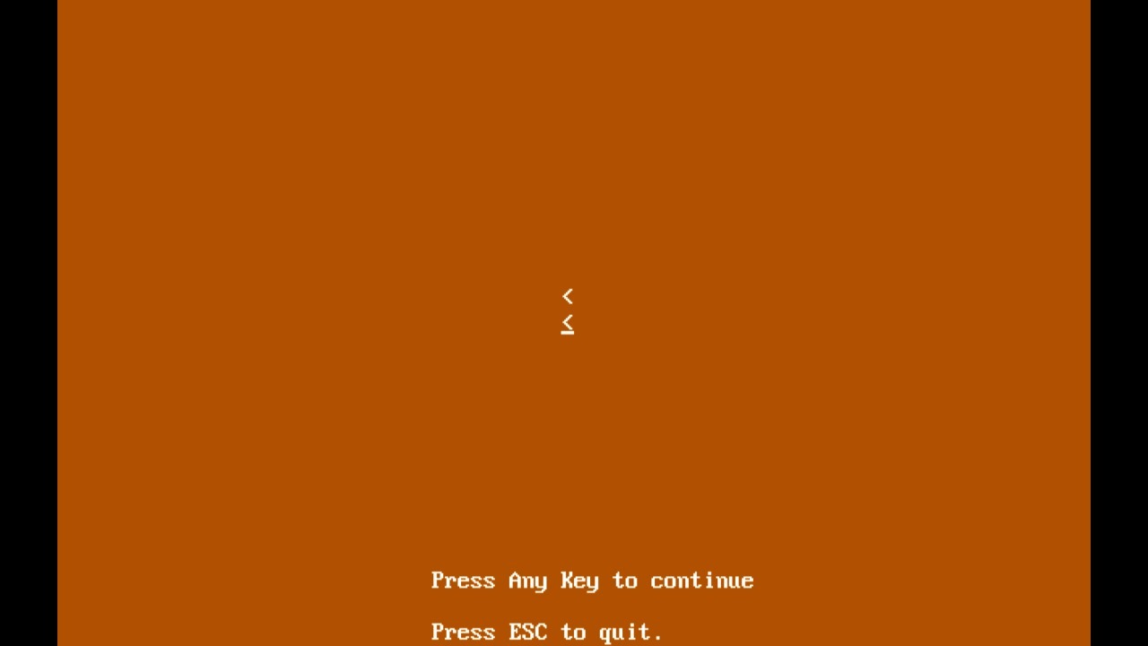

Slide 14
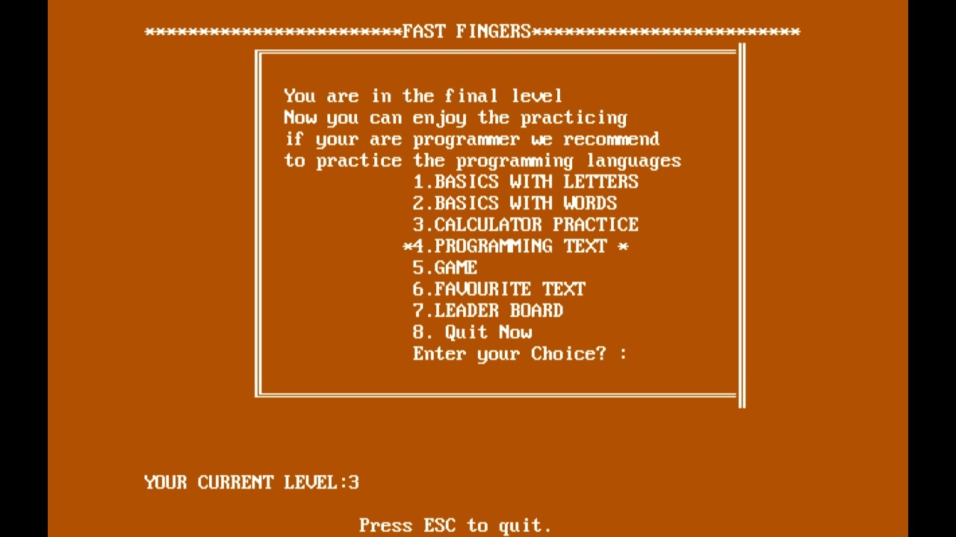

Slide 15
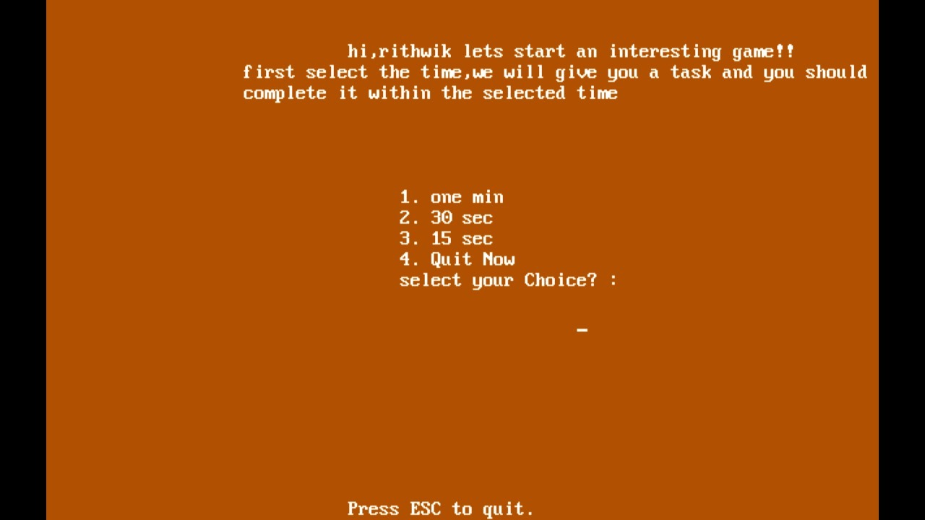

Slide 16
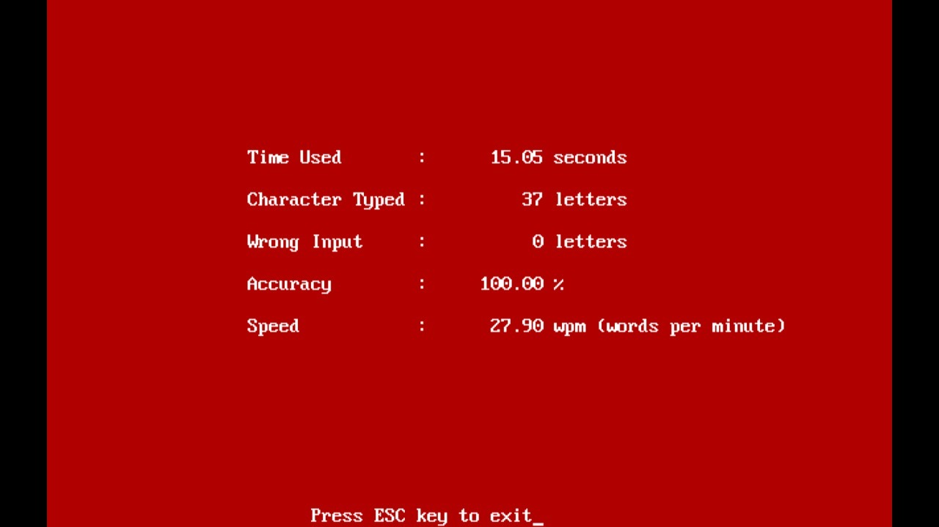

Slide 17
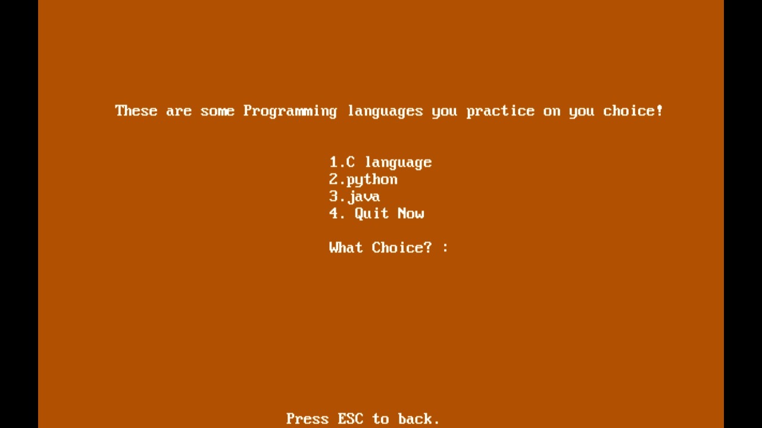

Slide 18
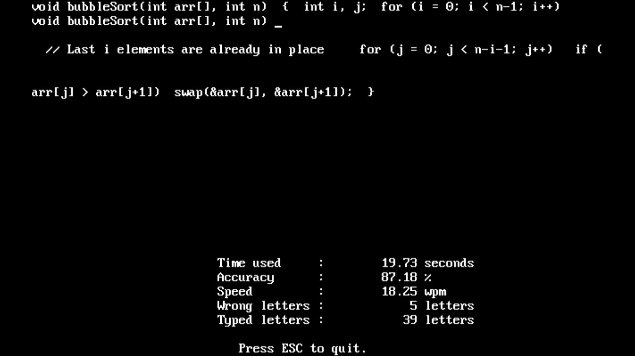

Slide 19
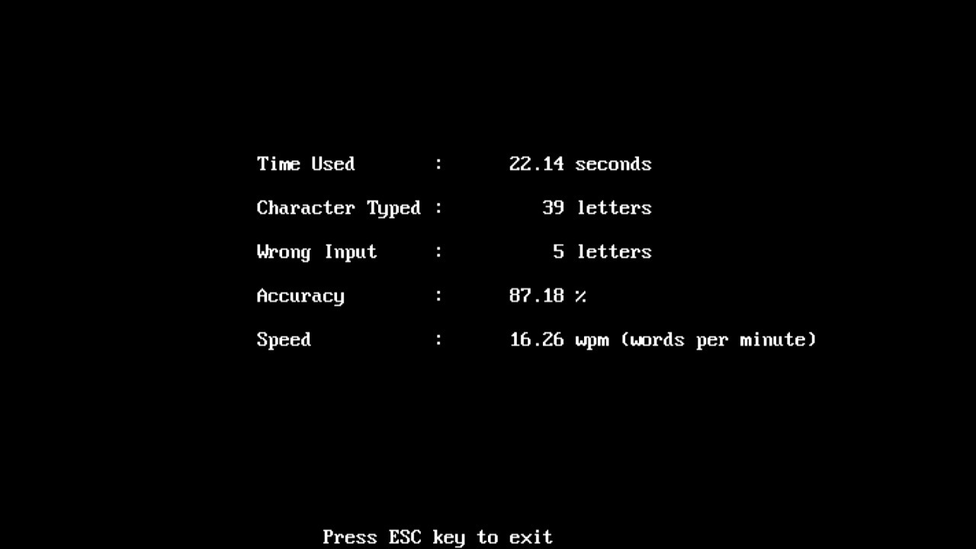

Slide 20
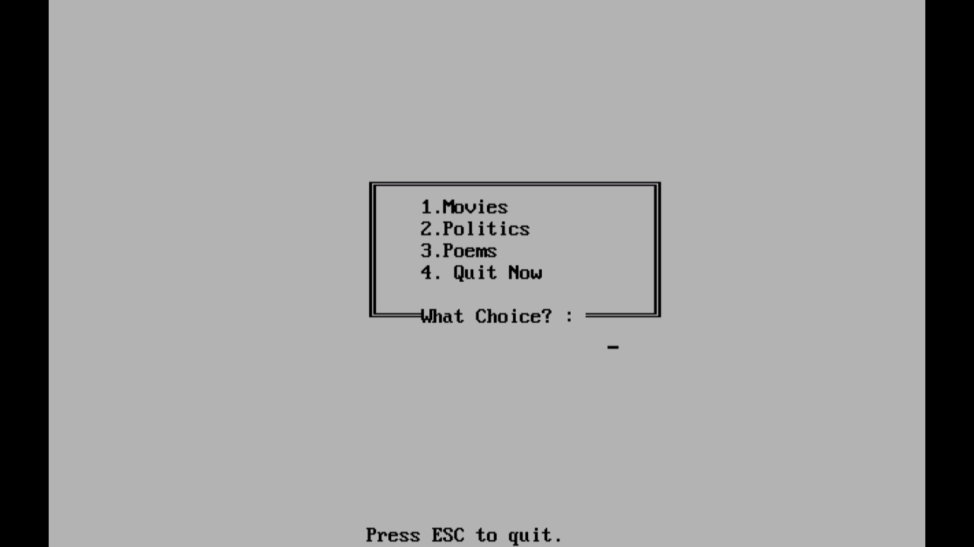

Slide 21
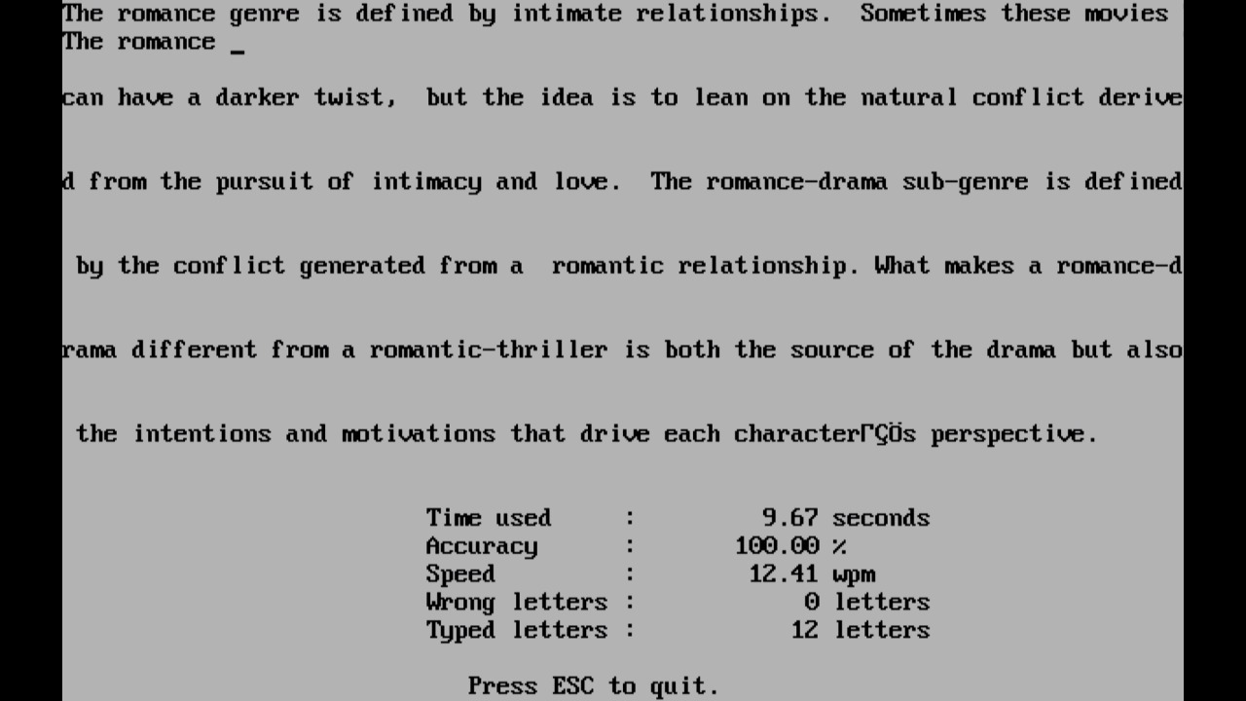

Slide 22
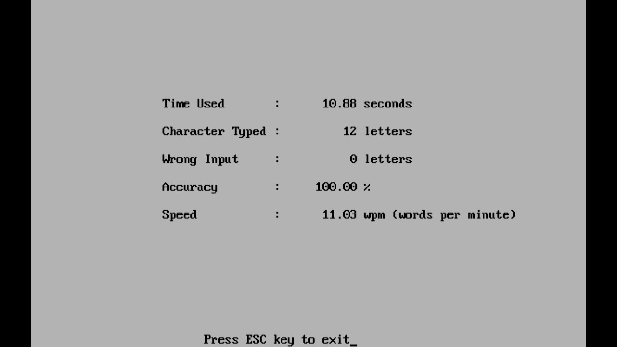

Slide 23
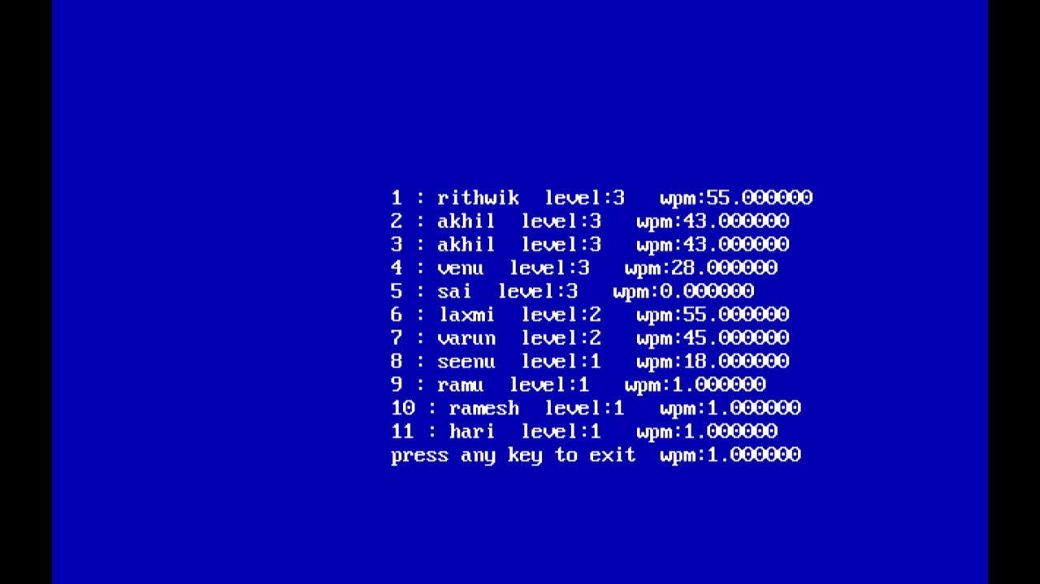

Slide 24
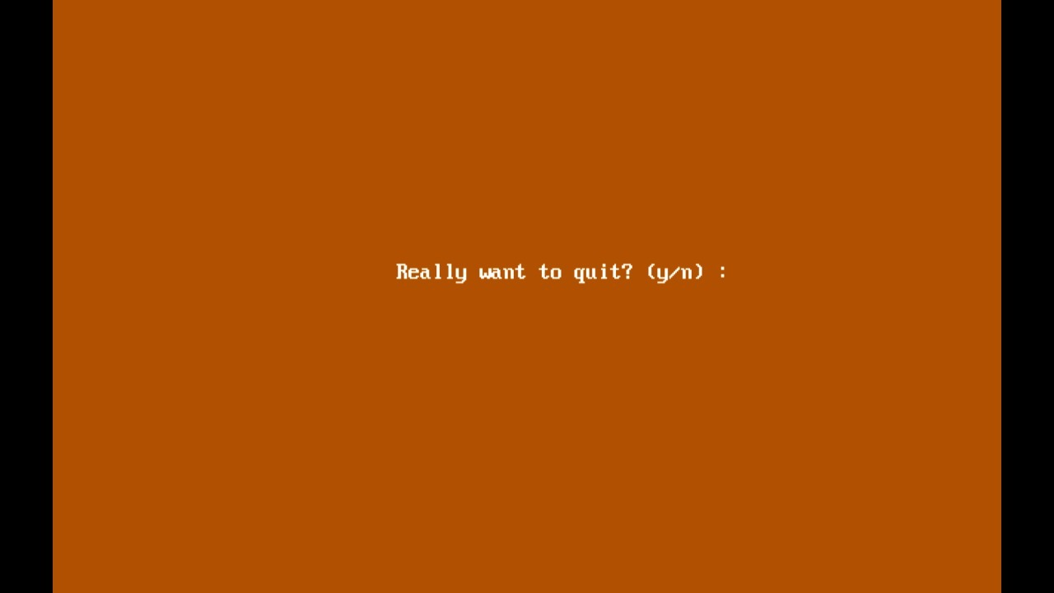

Slide 25
CONCLUSION AND FUTURE WORK
users feel comfortable while typing and they can execute them at top speed and users can also practice on programmingLaguages. Lastly, they do it without looking down at the keyboard!
In future We can add more graphics, games with best gui’s so that user will get the best practise in touch typing

Slide 26
Thank you
B.Saikumar Reddy-094
Akhil-064

